Slide 1
SAKAI

Slide 2
List of Menu after Registration
Overview
Profile
Membership
Calendar
Resources
Announcements
Worksite Setup
Preferences
Account
Help

Slide 3
Overview
Overview is also the Home page including 5 categories 1) MESSAGE OF THE DAY 2)CALENDAR 3)HOME INFORMATION DISPLAY 4)RECENT ANNOUNCEMENTS 5)MESSAGE CENTER NOTIFICATIONS
In (1), displays “MESSAGE OF THE DAY” and can edit message’s display with “OPTIONS” button.
In (2), displays the calendar and includes “OPTION” button to edit the calendar’s display and “PUBLISH(private)” button to publish a link of user’s calendar.
In (3), displays Welcome message.
In (4), displays announcements.
In (5), displays recent activities.

Slide 4
Profile
Profile includes 7 categories.
MY PROFILE
PICTURES
CONNECTIONS
MESSAGES
SEARCH
PRIVACY
PREFERENCES

Slide 5
(1) MY PROFILE
Can upload profile picture, can upload and save pictures to the folder “My pictures” and can upload status.
In Profile tab, user’s information such as email, staff info, student info, social networking, personal info can be described.
In Wall tab, displays the previous activities like wall posts, changing profile pictures, uploading pictures, and can give comments to these all.

Slide 6
(2) PICTURES
There are two folders “My pictures” and “Add picture”.
“My pictures” includes the previous uploaded photos.
“Add picture” includes “Choose File” button for uploading new pictures.

Slide 7
(3) CONNECTIONS
Search for connections is for searching new connection that is another person by name, e-mail or worksite. This is redirected to the “SEARCH” category.
When you click “Add Connection” to person, you still need to wait for confirmation of that person to create connection between you and another person.

Slide 8
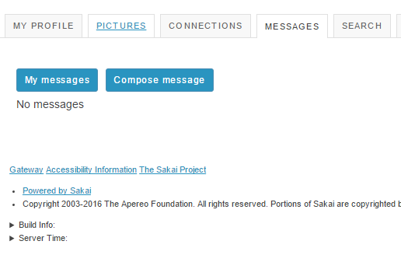
(4) MESSAGES
Includes “My messages” and “Compose message”.
My messages displays as the message inbox.
Compose message is for sending message to other connections.

Slide 9
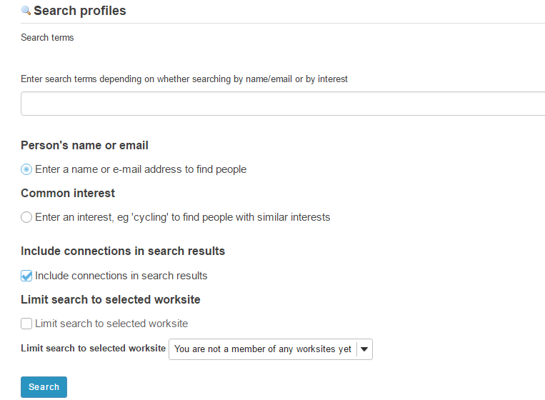
(5) SEARCH
SEARCH is redirected by the “SEARCH CONNECTION” of CONNECTIONS tab.

Slide 10
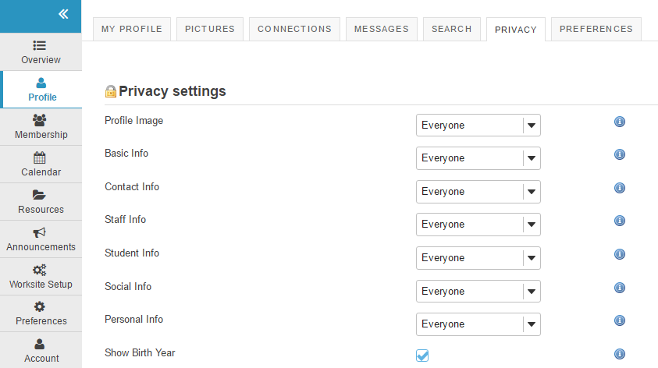
(6) PRIVACY
The privacy of the user profile’s information can be changed.

Slide 11
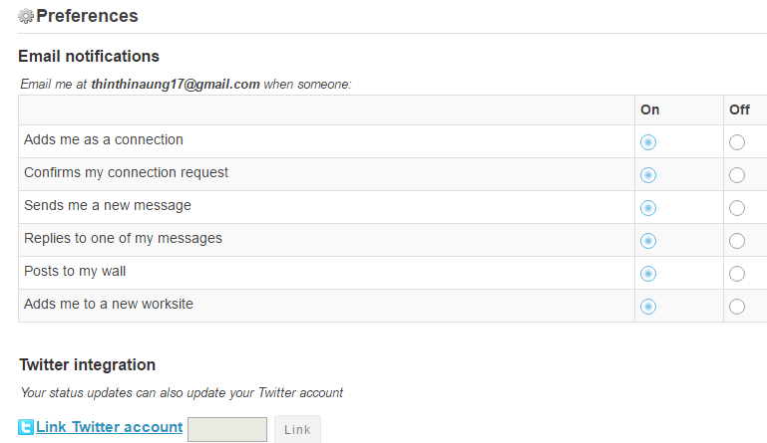
(7) PREFERENES
Controls email notifications setting, profile image setting, and widget setting, and subscribes the twitter account for updating status updates to Twitter.

Slide 12
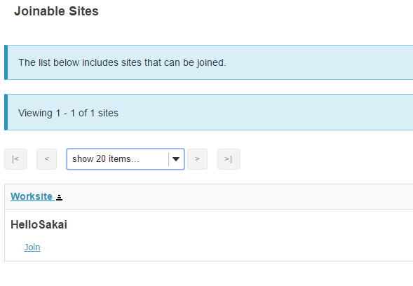
Membership
Includes “My Current Sites” and “Joinable Sites”.
My current sites shows the worksite that the user is in as a member.
Joinable Sites shows the list of sites that can be joined.

Slide 13
Calendar
Shows the calendar and can print the calendar.
Includes 7 tabs
ADD EVENT
IMPORT EVENTS
MERGE INTERNAL CALENDARS
MERGE EXTERNAL CALENDARS
PUBLISH (PUBLIC)
PUBLISH (PRIVATE)
FIELDS

Slide 14
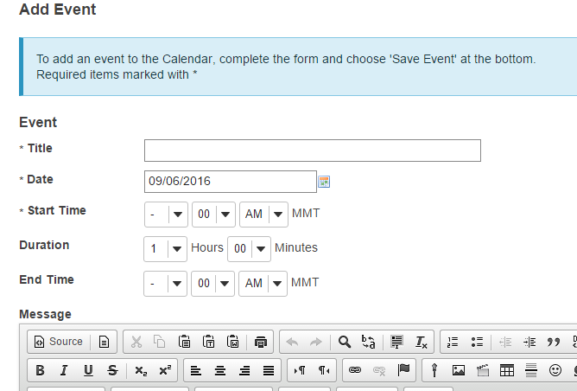
(1) Add Event
Add the new event and can add attachments to event.
Events shows in Calendar.

Slide 15
(2) Import Events
For importing calendar
4 types of calendar can be imported
Microsoft Outlook
Meeting Marker
iCalendar
Generic calendar import (comma-separate values)

Slide 16
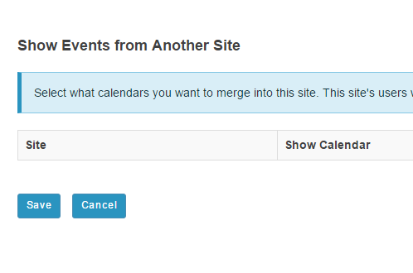
(3)Merge Internal Calendar
Merges calendars of the other sites.
The site’s users need to have permission to see these events in the source site.

Slide 17
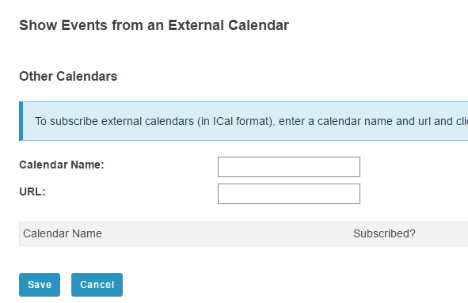
(4) Merge External Calendar
Adds the calendar of the searched URL.

Slide 18
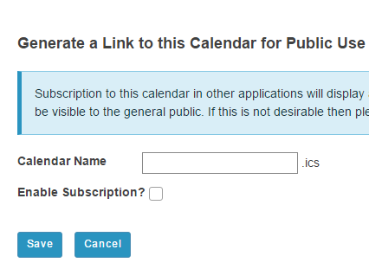
(5) Publish (Public)
Generating a link of the site’s calendar for public use
Authentication is not required and all events will potentially be visible to the general public.

Slide 19
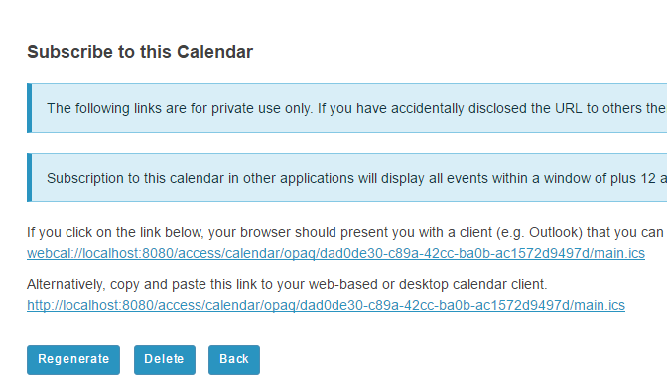
(6) Publish (Private)
Generating a link of the site’s calendar for private use only

Slide 20
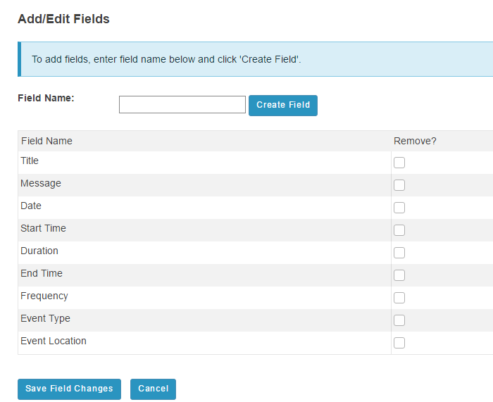
(7) Fields
Add or Edit fields including in creating events in the calendar.

Slide 21
Resources
Includes 5 categories
SITE RESOURCES
TRASH
TRANSFER FILES
OPTIONS
CHECK QUOTA

Slide 22
(1) SITE RESOURCES
Workspace is displayed and actions that can be performed about workspace are Upload File, Create Folders, Add Web Links (URLs), Create Text Document, Create HTML Page, Create Citation List, Copy, Edit Details, Compress to ZIP Archive, Move, Move to Trash, Edit Folder Permissions.

Slide 23
(2) Trash
Trash is where deleted files from the workspace are stored.

Slide 24
(3) Transfer File
The instructions on this page show you how to create a folder on your desktop machine that will allow you to drag and drop files and folders between your computer and this site’s Resources tool.
This involves using a protocol called WebDAV.
If you simply want to upload files to the Resources tool one by one, click “Site Resources” at the top of the page, then click Add>Upload Files to the right of a folder.

Slide 25
(4) OPTIONS
Setting options for resources of user’s worksite.
Select or unselect resource types to indicate whether resources of that type can be created in this site.
The options are:File Upload, Folder, Html Page, Reading List, Simple Text Document, Web Link(URL).

Slide 26
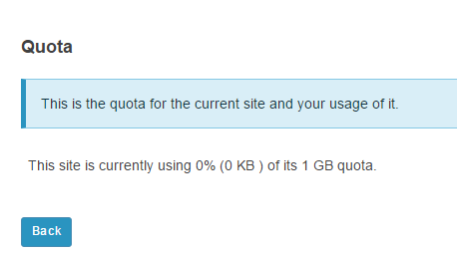
(5) CHECK QUOTA
This is the quota for the current site and your usage of it.

Slide 27
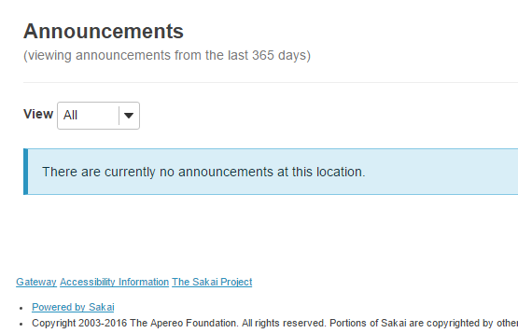
Announcements
Displays the announcements from the last 365 days

Slide 28
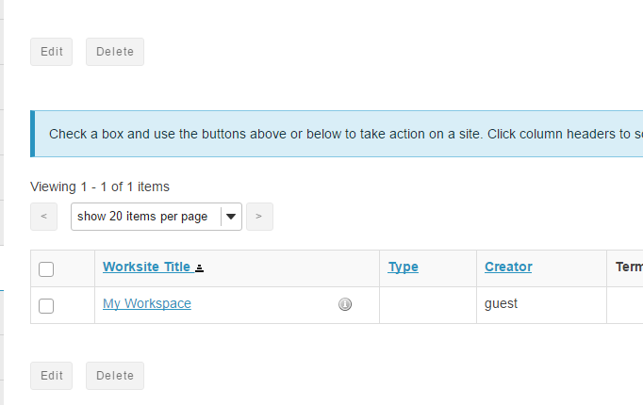
Worksite Setup
This is where worksites are edited and deleted.
Guest Account can’t create worksite.

Slide 29
Preferences
Includes 4 categories
NOTIFICATIONS
TIME ZONE
LANGUAGE
SITES

Slide 30
(1) Notifications
Change notification setting of the Announcements, Resources and Drop Box, Email Archive, Syllabus, Tests & Quizzes.

Slide 31
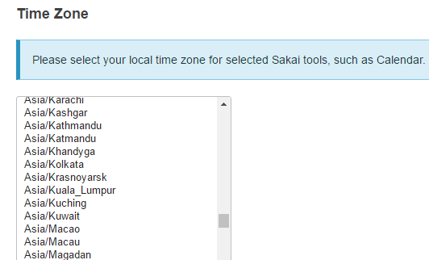
(2) Time Zone
Selects the local time zone

Slide 32
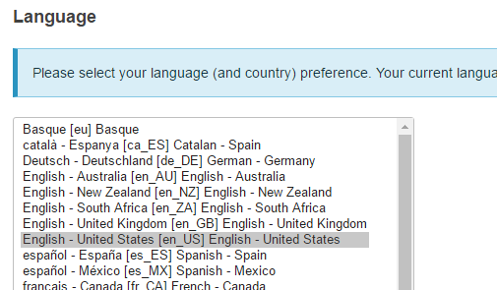
(3) Language
Selects the language(country)

Slide 33
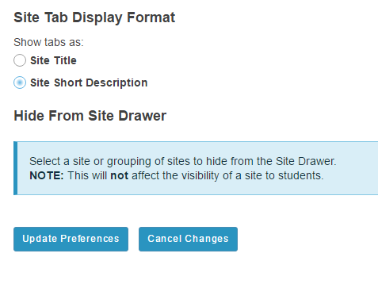
(4) Sites
Select as site or grouping of sites to hide from the Site Drawer. This will not affect the visibility of a site to students.

Slide 34
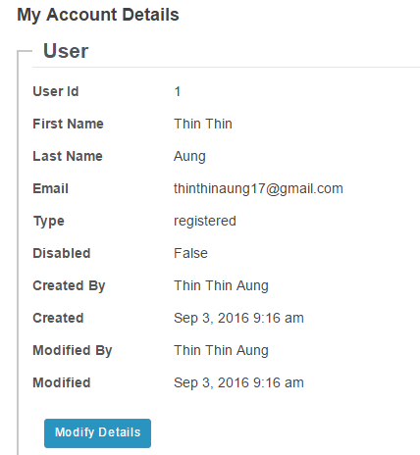
Account
Shows detail information about the logged in account and can edit the account’s information.

Slide 35
Help
Displays About Sakai Help in new window

Slide 36
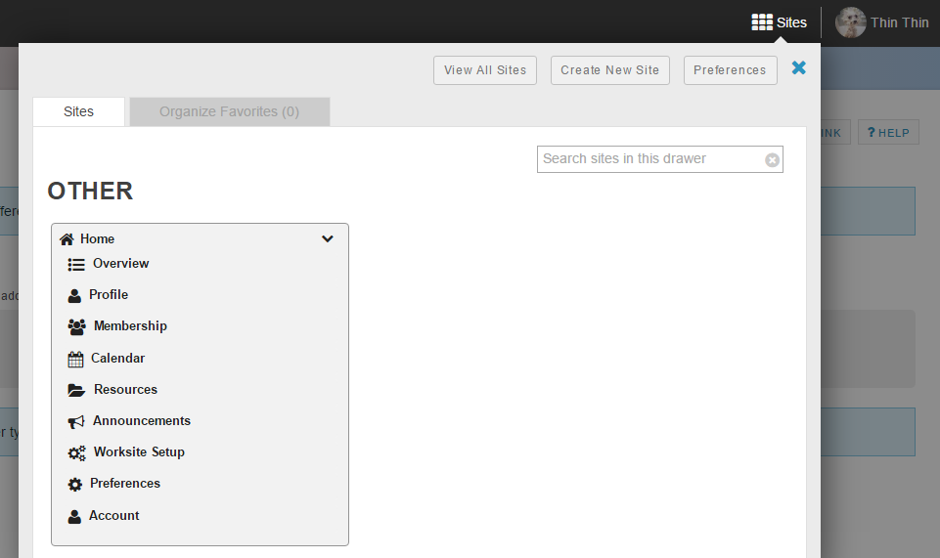
Sites on home menu bar
Create, view and search sites.

Slide 37
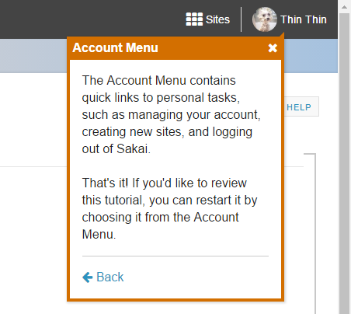
Profile on home menu bar

